Slide 1
Train/Test a New Deeplab V3+ Network
S. D. Gardner
AVMI – EITD – UAB
October 2022

Slide 2
1. Prepare Datasets
 | Image |  | Annotation
 | Type | Size | Type | Size
Dataset | .jpg | 1920x1200 | .png | 1920x1200
Image/annotation size can be any size greater than [224x224]
RUGD+RELLIS dataset has the format shown in the table above
See Slide 3-4 for more details
Image/annotation size must match and be consistent through dataset
Annotation colors/classes are defined within the code settings.
See Slides 5-9 for more details
Check for annotation consistency
e.g., multiple colors showing as a single class, multiple classes showing with single color, corrupted files, missing pixel colors, etc.
Relabel the annotations as necessary to match your wanted output
MATLAB code can be provided to do this task
Multiple classes can be grouped in the code (see Slide 8)
Save annotations and images into separate folders.
File types can be .png, .jpg, or .tiff
The file types are defined in the algorithm code
Make sure whatever extension is chosen is consistent through the dataset.

Slide 3
Example: RUGD + RELLIS (1/2)
 |  | Ontologies
ID | Class | RUGD | RELLIS | Simulator | Relabel
0 | void | [000 000 000] | [000 000 000] | [000 000 000]
1 | dirt | [108 064 020] | [108 064 020] | [108 064 020]
2 | sand | [255 229 204] | N/A | [000 102 000] | grass
3 | grass | [000 102 000] | [000 102 000] | [000 102 000]
4 | tree | [000 255 000] | [000 255 000] | [000 255 000]
5 | pole | [000 153 153] | [000 153 153] | [041 121 255] | barrier
6 | water | [000 128 255] | [000 128 255] | [000 128 255]
7 | sky | [000 000 255] | [000 000 255] | [000 000 255]
8 | vehicle | [255 255 000] | [255 255 000] | [041 121 255] | barrier
9 | object | [255 000 127] | [255 000 127] | [041 121 255] | barrier
10 | asphalt | [064 064 064] | [064 064 064] | [170 170 170] | concrete
11 | gravel | [255 128 000] | N/A | [255 128 000]
12 | mulch | [153 076 000] | N/A | [000 102 000] | grass
13 | rockBed | [102 102 000] | N/A | [041 121 255] | barrier
14 | building | N/A | [255 000 000] | [041 121 255] | barrier
15 | log | [102 000 000] | [102 000 000] | [041 121 255] | barrier
16 | bicycle | [000 255 128] | N/A | [041 121 255] | barrier
17 | person | [204 153 255] | [204 153 255] | [041 121 255] | barrier
18 | fence | [102 000 204] | [102 000 204] | [041 121 255] | barrier
19 | bush | [255 153 204] | [255 153 204] | [255 153 204]
20 | sign | [000 102 102] | N/A | [041 121 255] | barrier
21 | rock | [153 204 255] | N/A | [041 121 255] | barrier
22 | bridge | [102 255 255] | N/A | [041 121 255] | barrier
23 | concrete | [101 101 11] | [170 170 170] | [170 170 170]
24 | table | [114 085 047] | N/A | [041 121 255] | barrier
25 | barrier | N/A | [041 121 255] | [041 121 255]
26 | uphill | N/A | [101 031 255] | [108 064 020] | dirt
27 | downhill | N/A | [137 149 009] | [108 064 020] | dirt
28 | puddle | N/A | [134 255 239] | [000 128 255] | water
29 | mud | N/A | [099 066 034] | [099 066 034]
30 | rubble | N/A | [110 022 138] | [255 128 000] | gravel
 | Image |  | Annotation
 | Type | Size | Type | Size
RUGD | .png | 688 x 550 | .png | 688 x 550
RELLIS | .jpg | 1920x1200 | .png | 1920x1200
Dataset | .jpg | 1920x1200 | .png | 1920x1200
Convert RUGD sizes and data type to RELLIS sizes/types and save in the full dataset folder.
Relabel RUGD classes to match the colors of the final ontology and save.
Relabel RELLIS classes to match the colors of the final ontology and save.
Retrain the Deeplab V3+ algorithm on the full dataset folder
7,444 total samples
15 trail scene from RUGD
5 trail scenes from RELLIS-3D

Slide 4
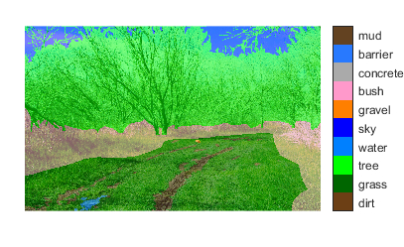
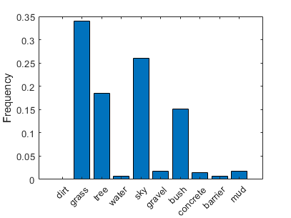
Example: RUGD + RELLIS (2/2)
 | Class | Final Ontology
0 | void | [000 000 000]
1 | dirt | [108 064 020]
2 | grass | [000 102 000]
3 | tree | [000 255 000]
4 | water | [000 128 255]
5 | sky | [000 000 255]
6 | gravel | [255 128 000]
7 | bush | [255 153 204]
8 | concrete | [170 170 170]
9 | barrier | [041 121 255]
10 | mud | [099 066 034]

Slide 5
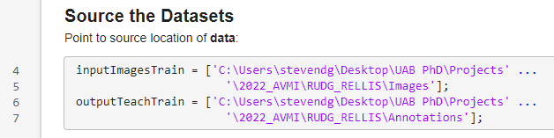
2. Point to Datasets
Open Deeplab_Node.mlx
Define the location of the saved images and annotations.

Slide 6
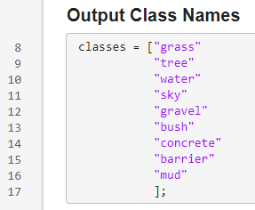
3. Define the classes
List the class names however you desire.

Slide 7
4. Define extensions
Open generateDatastores.mlx
Define image file type
Define annotation file type

Slide 8

5. Define pixel label IDs
Open dataPixelLabelIDs.m
If the annotation has multiple classes that you want to be grouped into 1 class, place the class you want grouped within the chosen class as follows:
Example:
Water is the desired class
Puddle will be redefined as Water
Other classes can be added by adding the semicolon, ellipses, and new line.
Define the RGB color for the annotation’s classes.
Group unwanted classes accordingly.

Slide 9
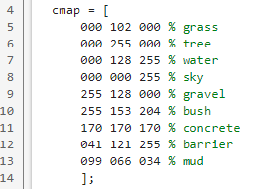
6. Define cmap
Open dataColorMap.m
Matching the order of the list in Step 3 (Slide 6), define the output class colors

Slide 10
8. Save the trained network
Return to Deeplab_Node.mlx
Define the trained network save name.
Example: ‘dlnet10.mat’ was chosen here
Run the program and let it train/test.
This may take several hours.
The trained network may now be invoked elsewhere.

Slide 11
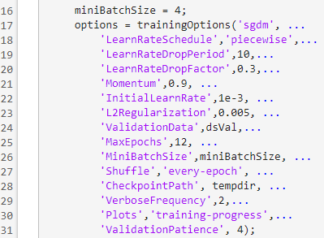
9. Common Troubleshoot Issues
Does the program throw an error that a class has no pixels in the dataset?
Every class must have at least 1 pixel in the dataset. Consider grouping the class into another class with pixels in the dataset.
Does it take an exceptionally long time to train? (5+ hours)
Likely, there is a class that has such few pixels in the dataset that the weights are enormous values, causing huge computing overhead.
Consider grouping the class with low pixel count into a similar class with greater pixel representation in the dataset.
Still very slow? Does it crash from high memory?
Open generateDLN.mlx
Reduce miniBatchSize to reduce GPU utilization.
Change the options as needed.

